Slide 1
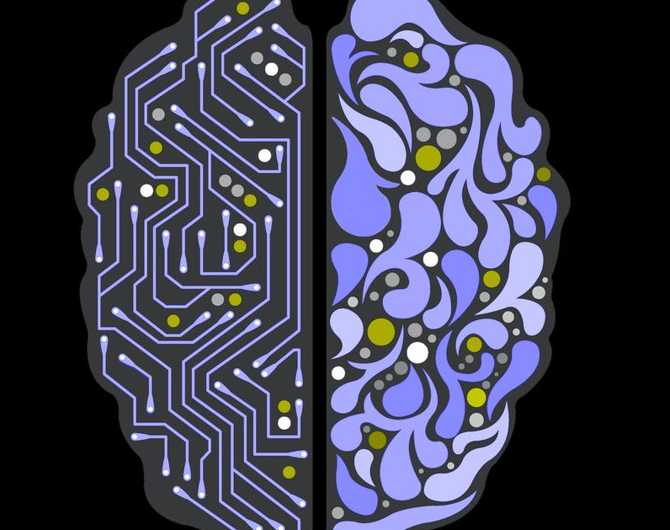
Ronen Reouveni Portfolio Presentation
Applied Data Science

Slide 2
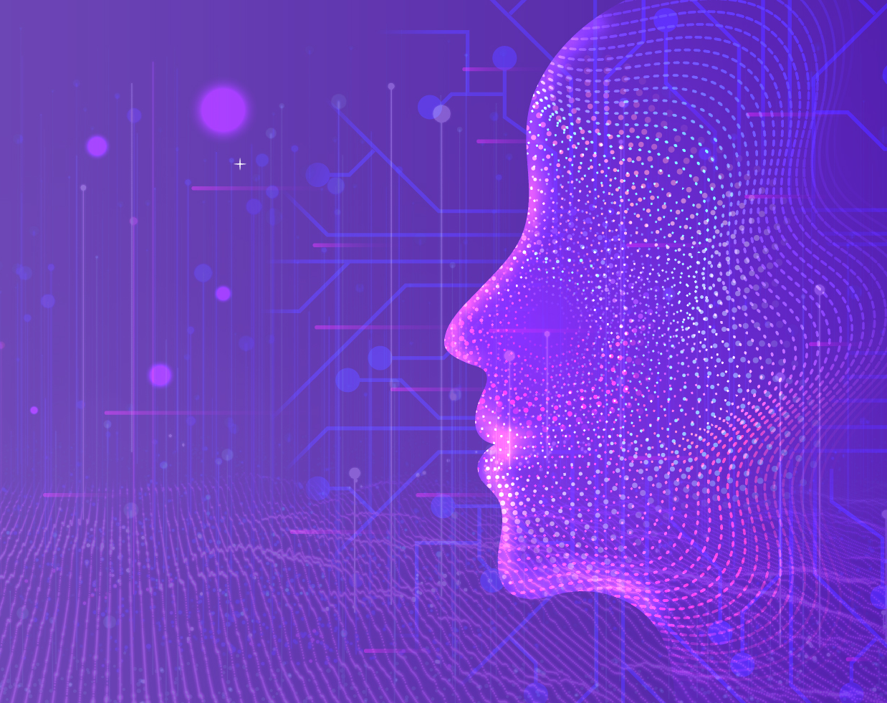
My Background
Education
Quantitative Economics and Econometrics at UCSD
Completed a 2 year web and software development bootcamp
Both led to strong programming skills and background in statistics and advanced mathematics
Work Experience
Co-founder of Random Golf Practice, we are a data driven iOS training aid for elite golfers
2k + subscribers (active users) this includes multile pga tour pros

Slide 3
Why Data Science
With a background in econometrics and software engineering, Data Science was the ideal next step to capitalize on my strengths
In graduate school, I have shown mastery of the programs' learning goals as demonstrated by my project portfolio
1. Describe a broad overview of the major practice areas in data science
2. Collect and organize data
3. Identify patterns in data via visualization, statistical analysis, and data mining.
4. Develop alternative strategies based on the data.
5. Develop a plan of action to implement the business decisions derived from the analyses.
6. Demonstrate communication skills regarding data and its analysis for managers, IT professionals, programmers, statisticians, and other relevant professionals in their organization.
7. Synthesize the ethical dimensions of data science practice (e.g., privacy)

Slide 4
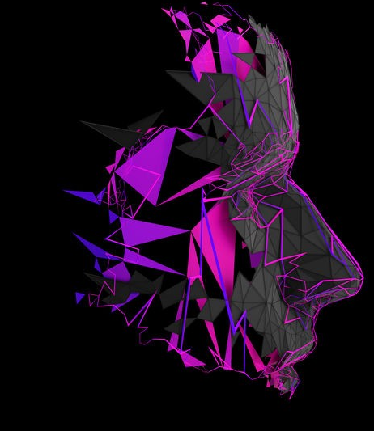
My Projects
My portfolio presented here will contain 6 projects.
These will cover natural language processing, computer vision, time series, and classical machine learning.
All of my projects except the last one presented here are implemented in Python

Slide 5

Rotten Tomatoes - NLP Overview
156,000 English phrases each with a sentiment label of 1-5, negative to positive.
Custom Sentiment Processing
I built a custom sentiminet processing function, that aggregates a sentiment score across a phrase based on my predefined rules
Machine Learning
I used Random Forests and Naïve Bayes to establish a baseline
Features included unigrams, bigrams, trigrams, and my custom sentiment scores
Deep Learning
Since language is built up of sequences, maintaining the order of words is essential. Using Tensorflow and Keras I implemented multiple LSTM's to predict sentiment
These models far outperformed the traditional modeling techniques
"You are neither boring nor mean"
Textblob -.65,
Custom score .45.

Slide 6
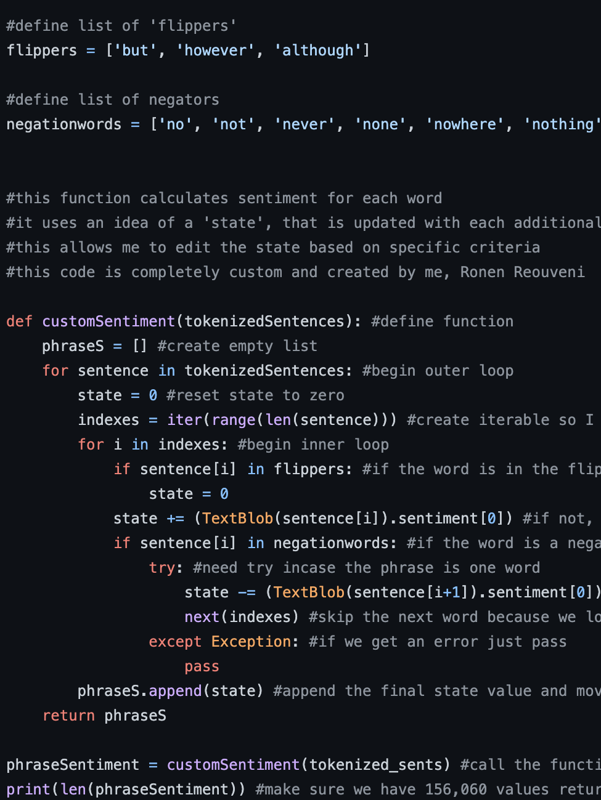
Learning Goals
Learning goal #4: develop alternate strategies based on data
Language is sequences, this means a sequenced based model will outperform traditional models
The use of LSTM's over traditional ML demonstrates an ability to develop alternate strategies based on data.
Learning goal #6: Demonstrate communication skills
Adjusted the type of language used to communicate ideas and findings
Information must be digestible to other programmers and non-technical stakeholders with asymmetrical technical skills

Slide 7




Web Scraping - NLP Trip Advisor Reviews
Having labeled data in the form of review and adjacent rating lends itself well to machine learning. Random Forests and Extreme Gradient Boosting were implemented to predict sentiment from review.
Built a custom webscrapper in python using BeautifulSoup to capture 14k hotel reviews and data from TripAdvisor
Processed and stored in a MongoDB
My pipeline created processes and organizes all the data before storing in the MongoDB. This allowed me flexibility on how I analyzed the data.
Text Mining
I found that price was not a predictor of a reviews' rating, but as price changes the reasons for a good or bad review also change. Ex. More expensive means better service, while more inexpensive prioritizes cleanliness.
Machine Learning for Sentiment
Web Scraping

Slide 8
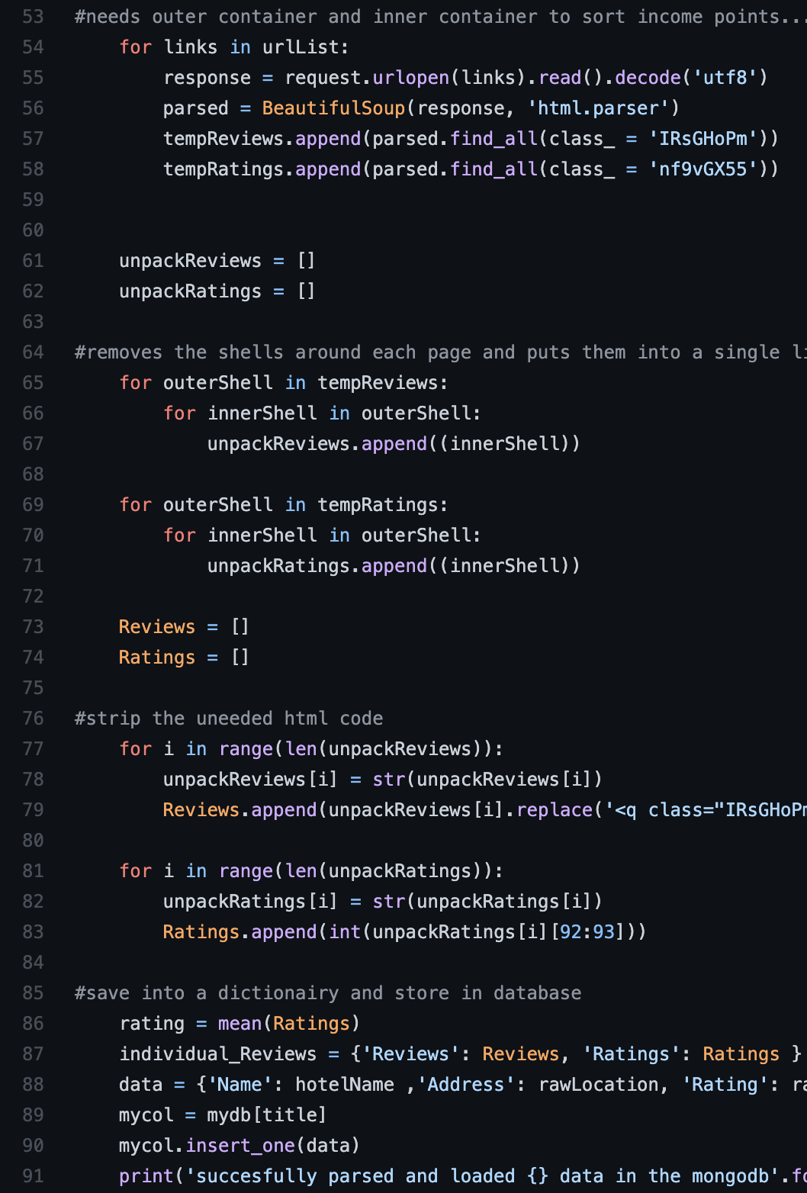
This image is a portion of the web scraping script I wrote. Here I show how it targets specific HTML classes, then parses it, and finally stores it in my MongoDB.
Learning Goals
Learning goal #2: collect and organize data
Built a custom web scraper to collect my own data
Takes a trip advisor link as input and scrapes all reviews, ratings, hotel name, and address.
Processes and stores the data in a MongoDB to be later used with ML
Successful implementation demonstrated achievement of learning goal #2

Slide 9




Chest X rays - Computer Vision Transfer Learning
Modeling showed that there were features between the classes irrelevant to the task. Ex. Covid-19 patients tended to be elderly, while pneumonia patients young. Thus the classes were often distinguishable for reasons other than chest infection.
6,000 chest x rays that are either normal, show pneumonia, or covid-19 pneumonia The goal is to build a classifier, but the problem is a lack of data.
Data Augmentation
During training, images are rotated and cropped, this helps with generalization and artificially generates more training observations
Convolution and Transfer Learning
I used various pretrained models as a set of base layers. These were non trainable and intended to work as a feature transformer. I then trained various convolutional layers on top of these base layers. This improves results dramatically.
Results
The Data

Slide 10
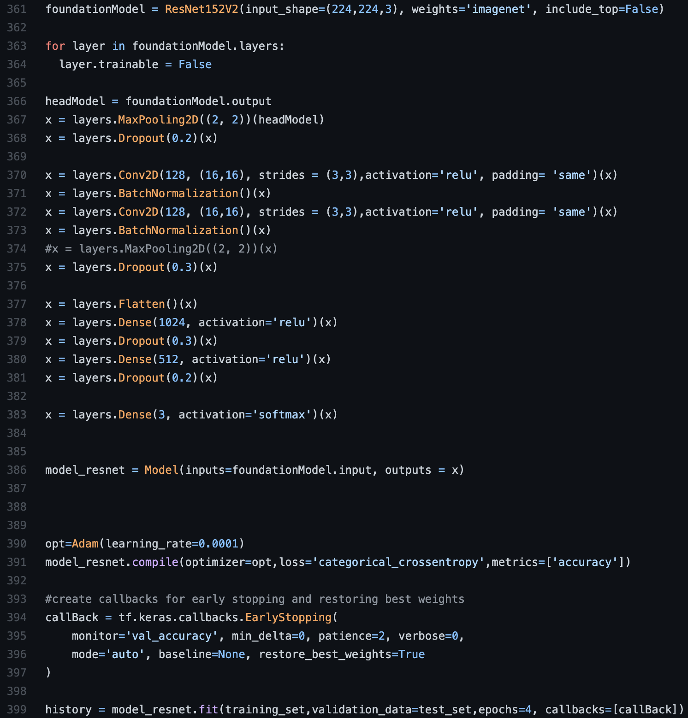
This code shows instantiating the ResNet architecture, and applying my own trainable layers on top of it.
Learning goal #4: develop alternate strategies based on data
Limited size of dataset and nuanced problem
Required more data or alternative strategies
Otherwise, convergence is improbable
Data Augmentation artificially adds more training examples
Transfer Learning leverages the power of pre-trained feature transformers
Understanding these strategic initiatives demonstrate achievement of learning goal #4

Slide 11
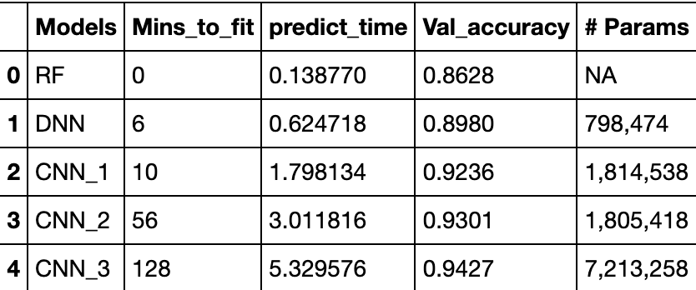
Fashion MNIST - Computer Vision Advanced CNN's
This classic dataset has been a benchmark in computer vision for years.
I show how to get cutting-edge performance using repeating convolutional blocks. To fight over-fitting each relevant layer includes L2 regularization. The structure of the blocks also includes dropout. These blocks included layers of:
Convolution
Batch Normalization
Convolution
Batch Normalization
Max Pooling
Dropout
This pattern is repeated with increasing number of filters

Slide 12
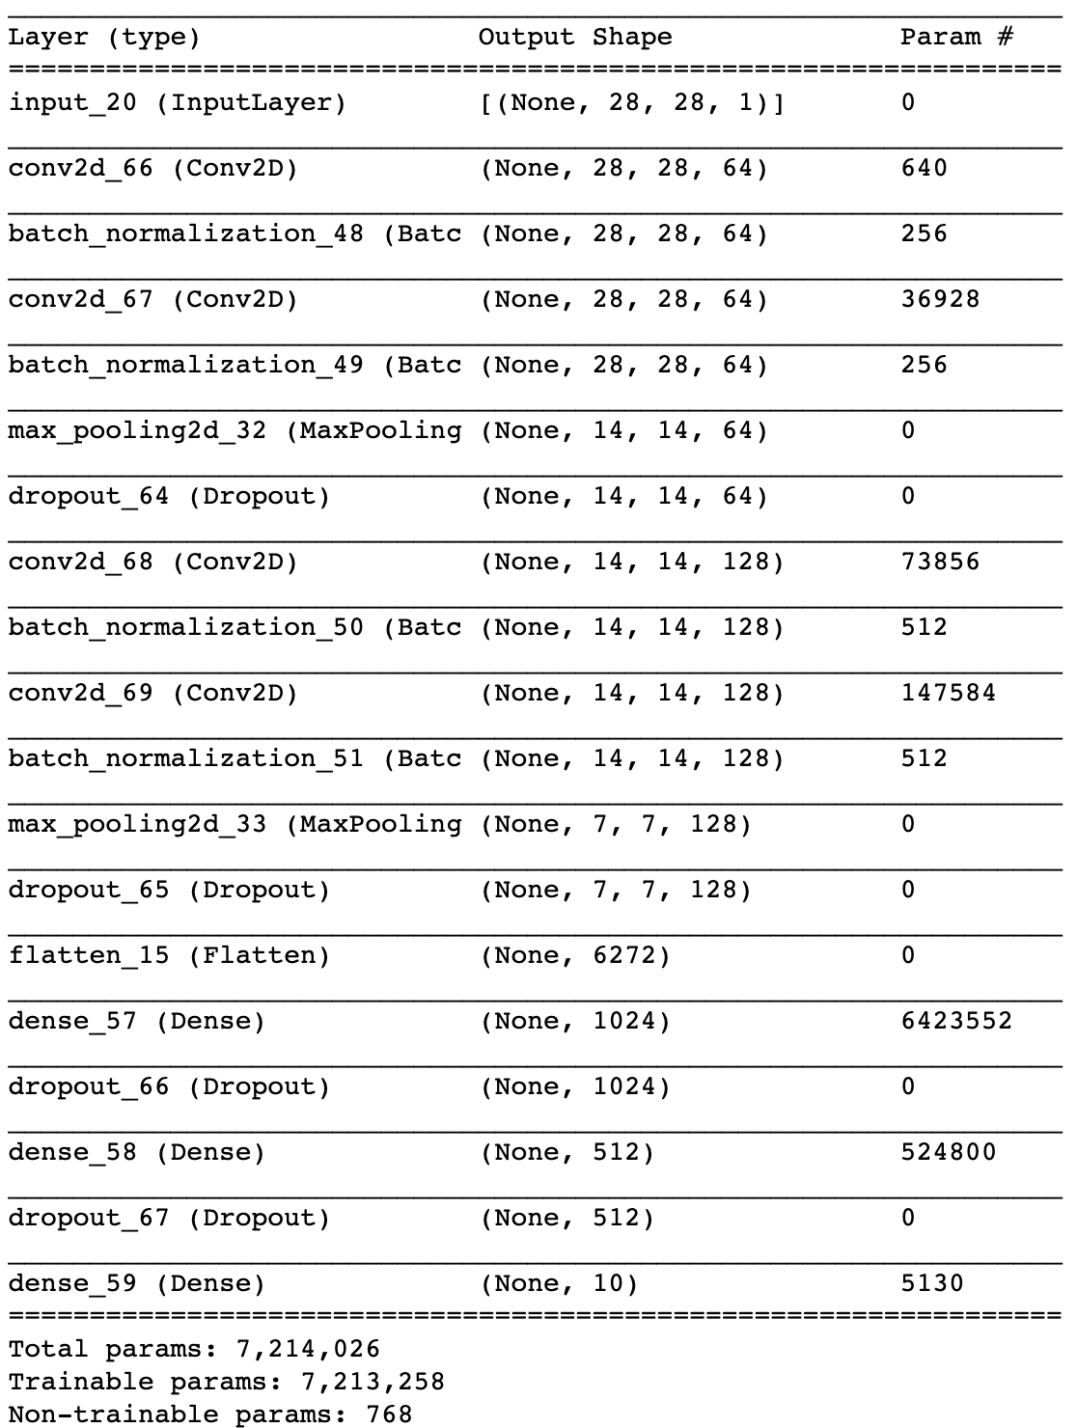
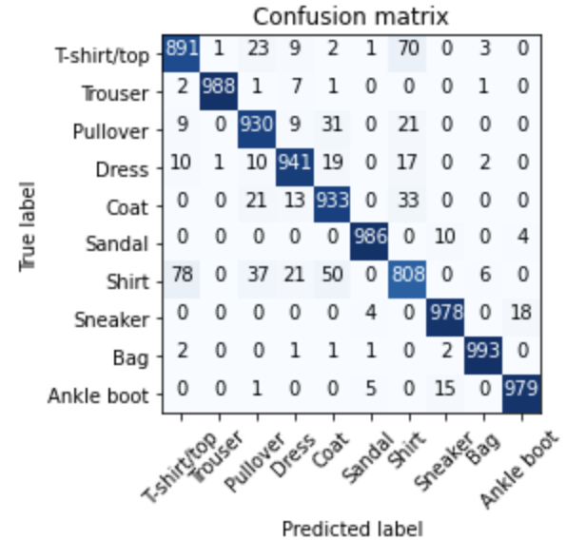
Learning goal #3: identify patterns in data via visualization, statistical analysis, and data mining
Used confusion matrices to see where neural nets were underperforming
This, in conjunction with visualizations of resulting accuracies and convergence indicated overfitting
Added L2 regularization and dropout to combat this and refine the model
This allowed detailed refining of the model to achieve superior accuracy

Slide 13
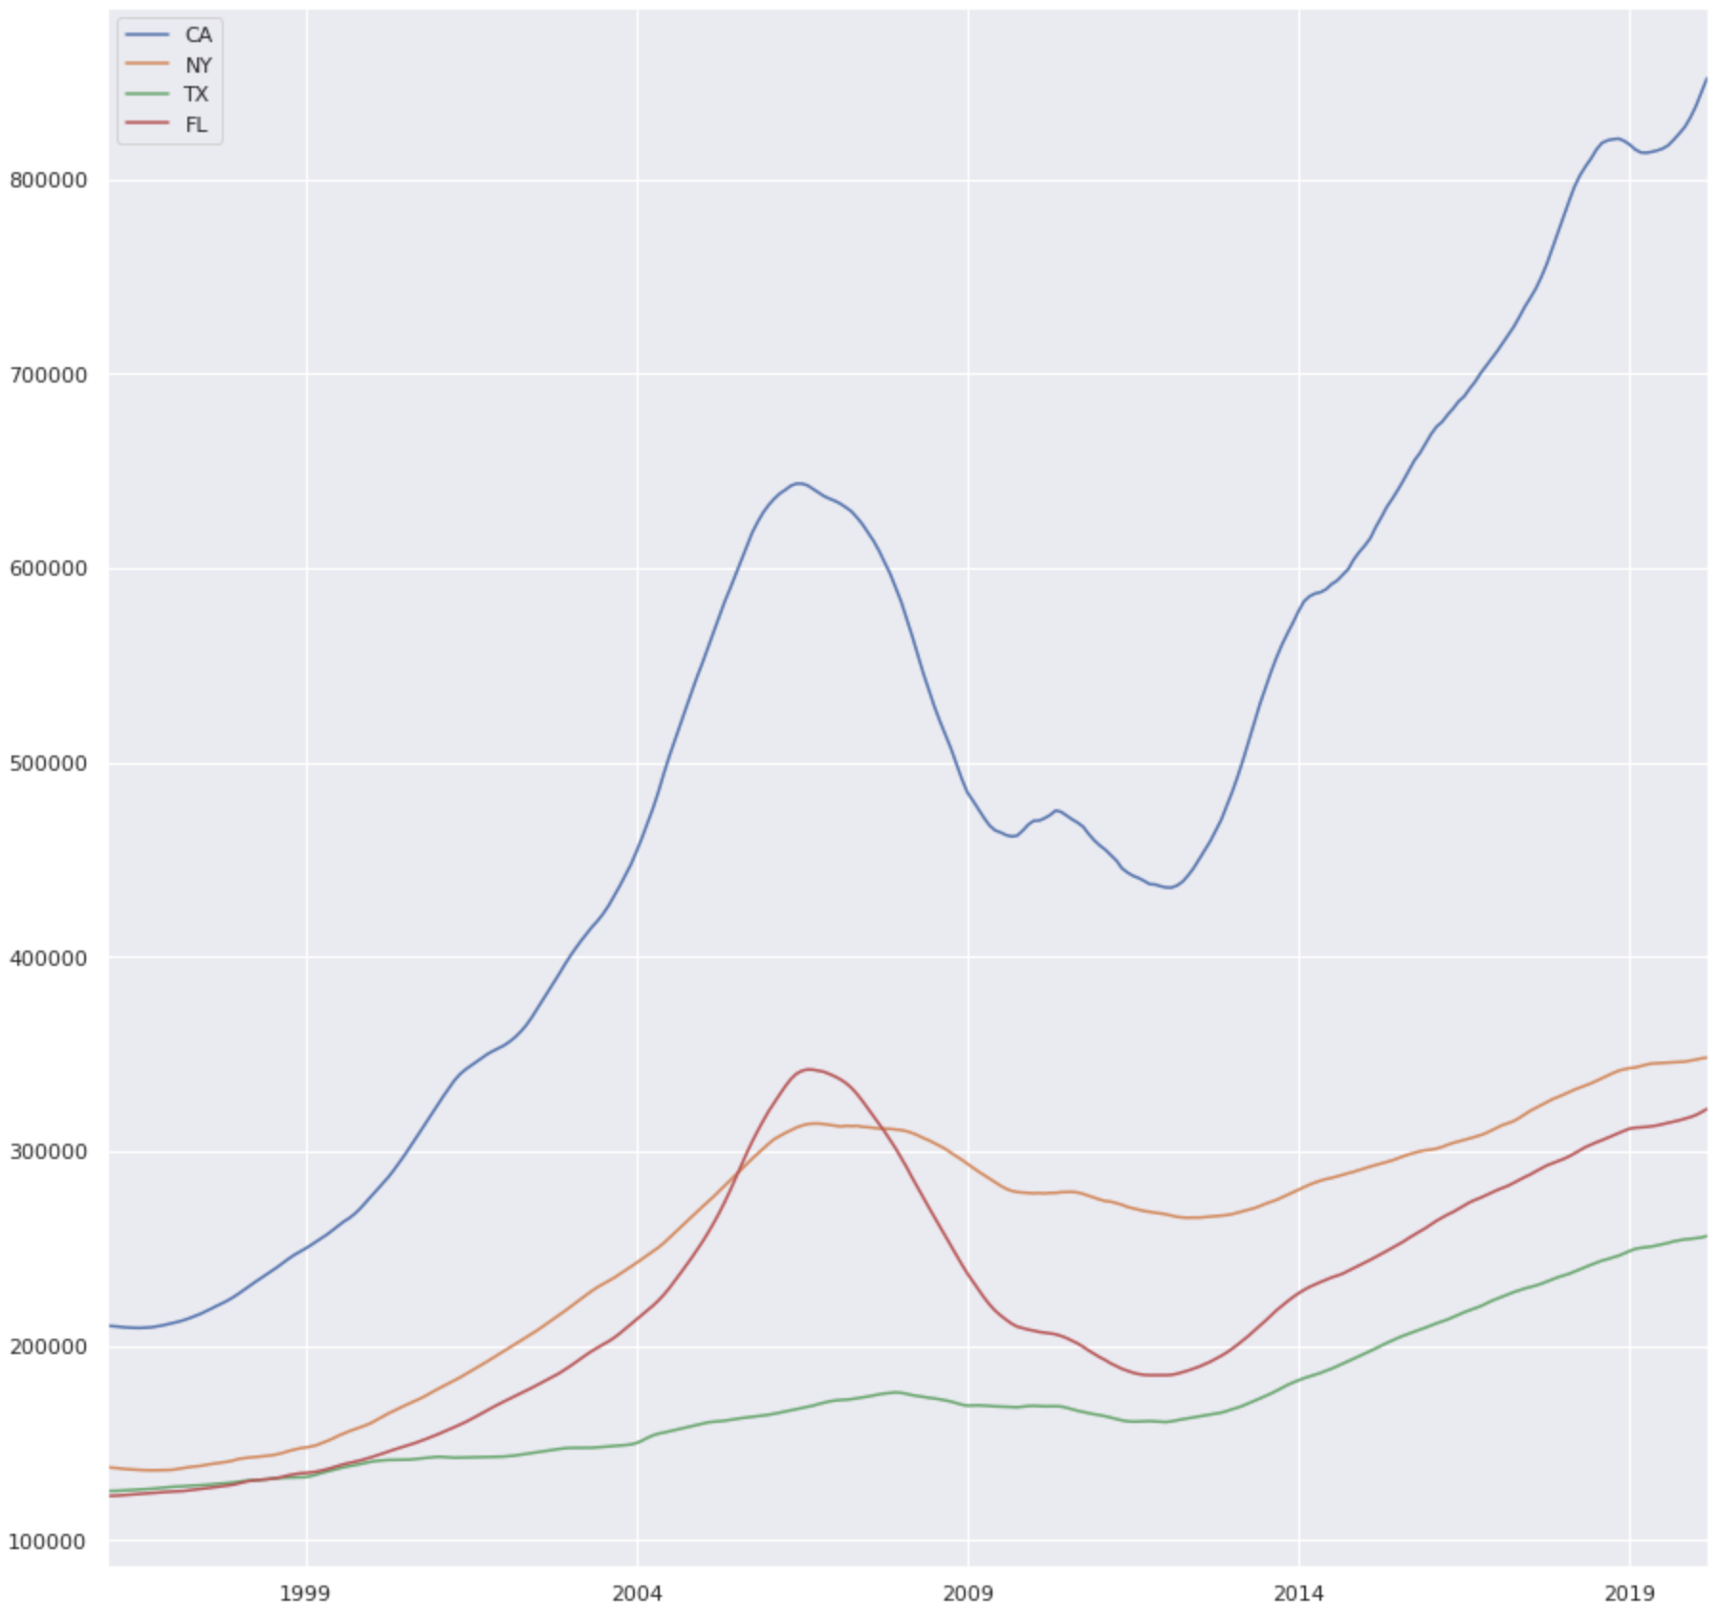


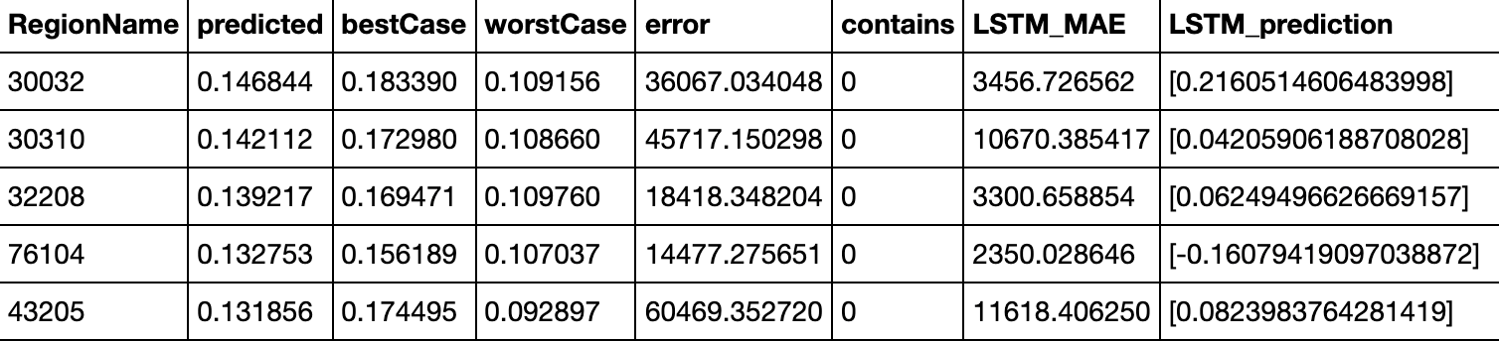
Zip Codes and Housing prices – Time Series Deep Learning
Monthly data going back 20 years on the median home value in each zip code across the USA.
Facebook Prophet
Facebooks Prophet was the first predictive model implemented. I found that when split into testing and training, very few of the prophet's predictions were close to the true values
Deep Learning, Bidirectional LSTM
Because time series data is sequences, we can model them using Bidirectional LSTM's. This modeling approach when split into training and testing sets outperformed the prophet substantially
The Data

Slide 14
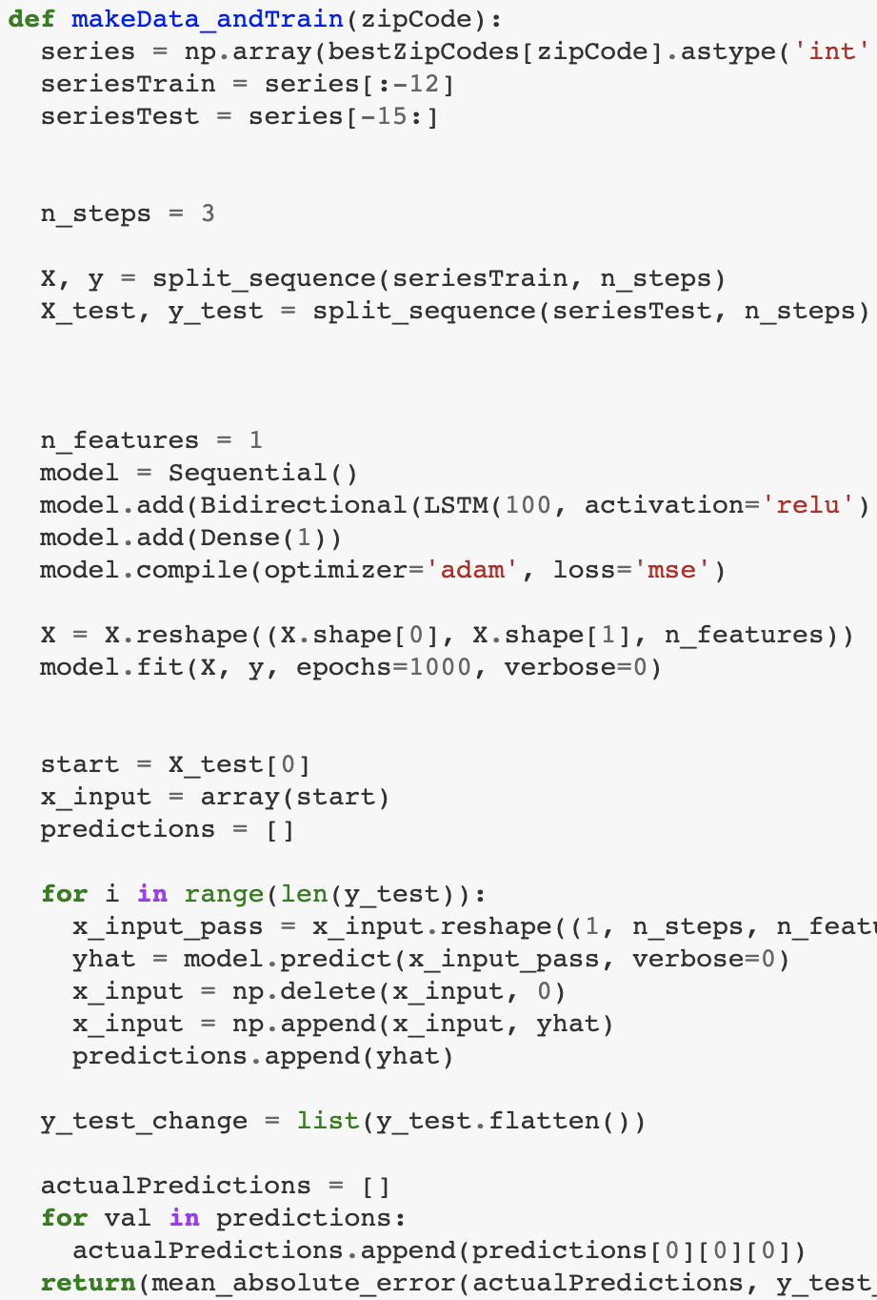
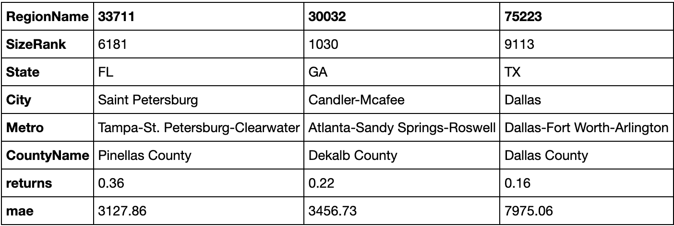
This custom function takes a zip code's data and splits it into train and test. It then fits a Bidirectional LSTM on the train set and calculates mean absolute error.
Learning Goals
Learning goal #5: Develop a plan of action to implement the business decisions derived from the analyses
Zip codes were selected based on out of bag predicted returns and confidence levels
Based on this, a plan of action was implemented to make an investment in the top 3 zip codes
This shows achievement of learning goal #5

Slide 15

Bias in Machine Learning – Ethics
A classic classification problem is predicting loan defaults.
In this project, I demonstrated that fitting a Random Forest on this data results in large discrepancies between races and ethnicities.
I define the target error as the rate of wrongly predicted defaults given an observations race.
I then explicitly showed that this rate was very different from race to race.
Native Americans were 20% more likely to be misclassified than whites
African Americans were 10% more likely to be misclassified than whites
White and Caucasian people were about 10% more likely to be misclassified than Asians

Slide 16
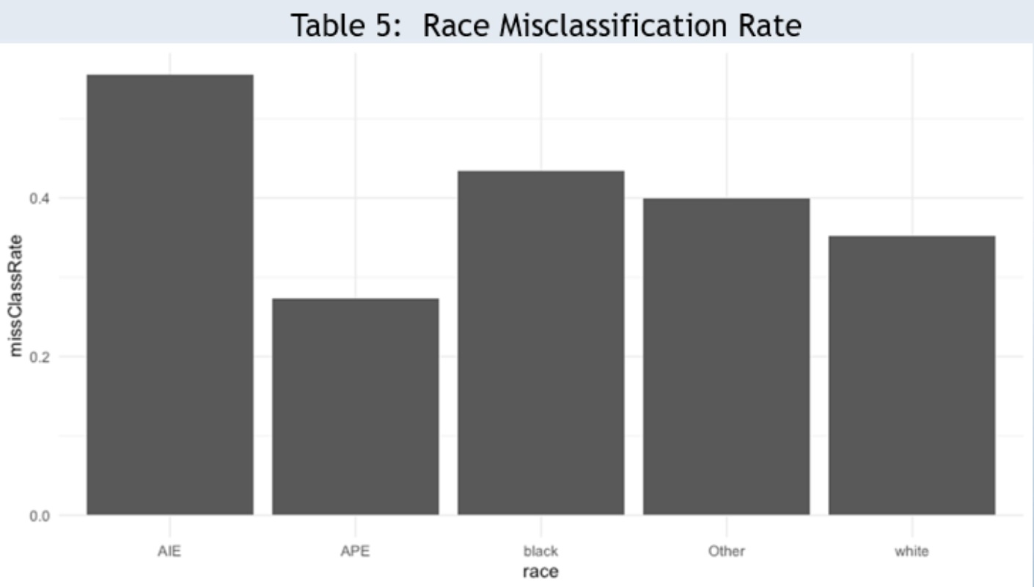
Learning goal #7: Synthesize the ethical dimensions of data science practice (e.g., privacy)
Results from analyses can fundamentally affect aspects of people's lives
This project demonstrates that ML models can be susceptible to discrimination.
Data scientists must be aware of this fact and understand the role of ethics and the impact they have
Demonstrating achievement of this learning goal is fundamental to a career in data science

Slide 17
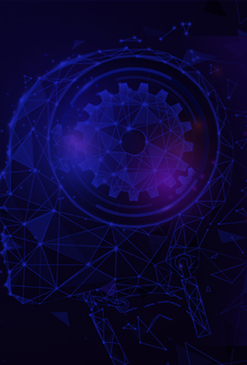
Learning Goals
Learning goal #1: describe a broad overview of the major practice areas in data science
This presentation, and portfolio included projects in
NLP
Computer Vision
Time Series
Classical Machine Learning
These projects provide a broad overview of the major practice areas in data science
They show an ability to discuss and solve problems in these spaces
Therefore, these projects and their respective reports, exemplify achievement of learning goal #1
Furthermore, through this portfolio, all learning goals are firmly satisfied

Slide 18

I love Data Science and the Master's program at Syracuse has given me the opportunity to develop skills and demonstrate them through hands on projects. 4 of these 6 projects included deep learning models implemented in Tensorflow and Keras.
LSTM's for time series
LSTM's for NLP
Convolution for computer vision
I look forward to my future career and using these skills in a professional environment.

